Slide 1
NTE 1010 - Introduction to Finance for Engineers
Spring 2020
week 2
Financial Statements

Slide 2
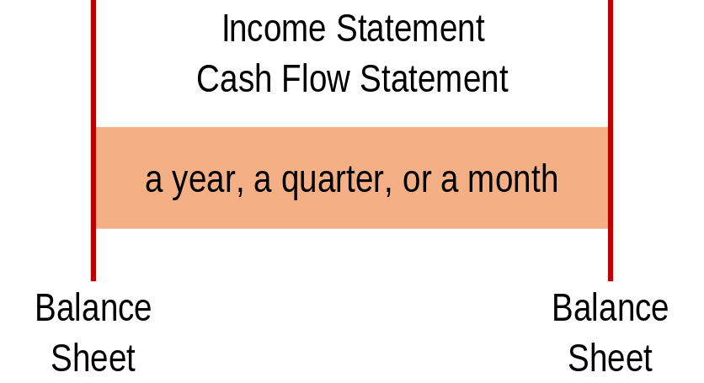
NTE 1010 – Introduction to Finance for Engineers
Reports of Financial Accounting
  Three major financial statements that form the core of financial accounting:
  Balance Sheet
    shows the accumulated wealth of the business at the end of the period,
  Income Statement (also known as Profit and Loss Account)
    shows the wealth (profit) generated or lost by the business during the period,
  Cash Flow Statement
    shows the cash in and cash out during the period.
  Taken together, they provide an overall picture of the financial health of the business.

Slide 3
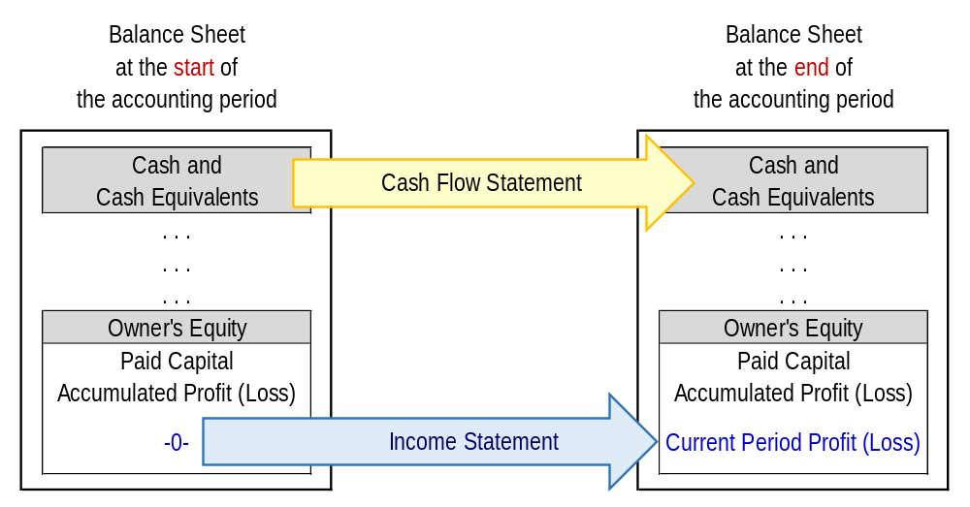
NTE 1010 – Introduction to Finance for Engineers
Relationship among Primary Financial Statements

Slide 4
Balance Sheet
Income Statement
Cash Flow Statement

Slide 5
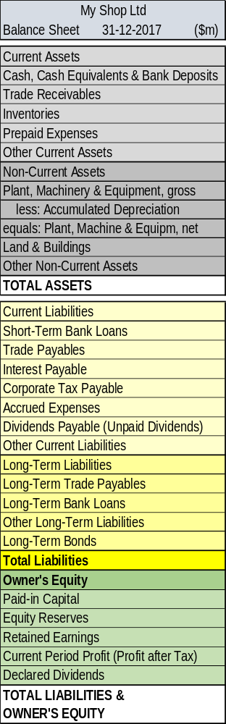
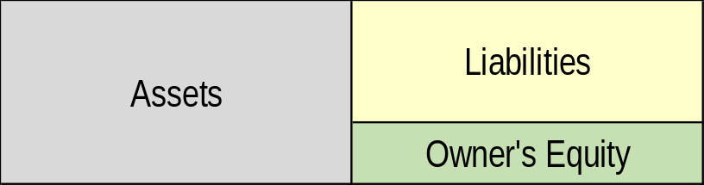
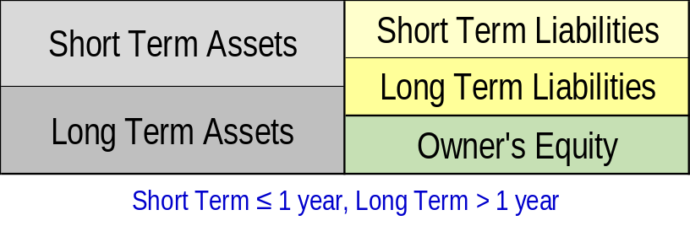
NTE 1010 – Introduction to Finance for Engineers
Major Financial Statements
Balance Sheet
  what is the accumulated wealth of the business (Owners’ Equity)
  at the end of a particular period
  Basic Structure of a Balance Sheet
  + Assets (resources held by the business)
  - Liabilities (obligation of the business to provide cash, or some other form of benefit to other individuals and organizations apart from the owners)
  = Owner’s Equity (accumulated wealth of the business)

Slide 6
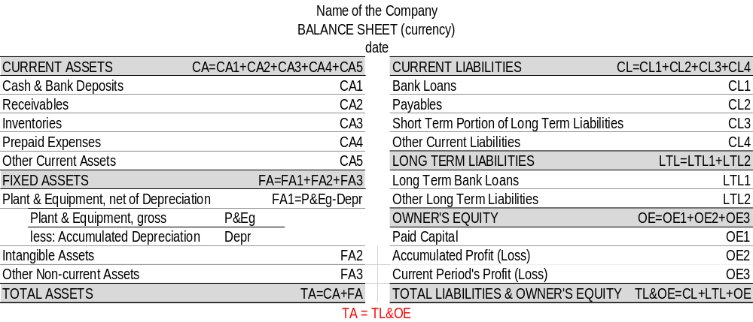
NTE 1010 – Introduction to Finance for Engineers
Balance Sheet
Basic Structure

Slide 7
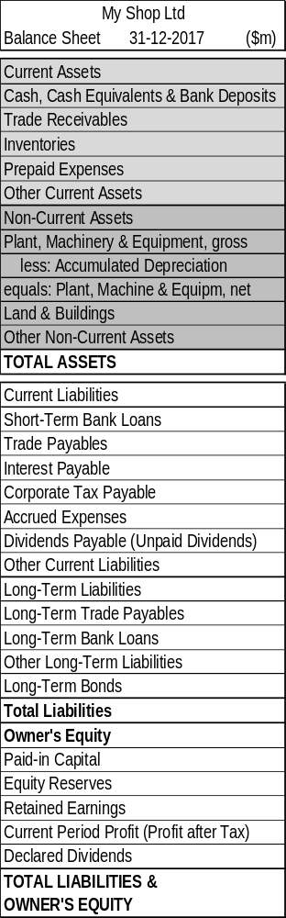
NTE 1010 – Introduction to Finance for Engineers
Balance Sheet
Assets
  For a particular item to be treated as an asset for accounting purposes,
  it should have the following characteristics.
  A probable future benefit must exist.
  The business must have an exclusive right to control the benefit.
  The benefit must arise from some past transaction or event.
  The asset must be capable of measurement in monetary terms.
  Note that all four of these conditions must apply.
  Still, some resources not satisfying all four may well be assets in a broader sense, but not for accounting purposes.
  Once an asset has been acquired by a business, it will continue to be considered an asset until the benefits are exhausted or the business disposes of it in some way.
  Assets that have a physical substance and can be touched are referred to as tangible assets.
  Assets that have no physical substance but which, nevertheless, provide expected future benefits (such as patents) are referred to as intangible assets.

Slide 8
NTE 1010 – Introduction to Finance for Engineers
Balance Sheet
Assets
  Current assets are basically assets that are held for the short term.
  They have to meet any one of the following four criteria:
  held for sale or consumption in the normal course of a business’ operating cycle
  are for the short term (i.e. to be sold within a year)
  are held primarily for trading
  are cash, or near cash such as easily marketable, short-term investments
  The most common current assets are inventories (or stock), customers who owe money for goods or services supplied on credit (known as trade receivables or debtors), and cash.
  Non-current assets (also called fixed assets) are assets that do not meet the above criteria.
  They are held for the long-term operations of the business.
  Essentially, they are ″tools″ of the business and are held with the objective of generating wealth.

Slide 9
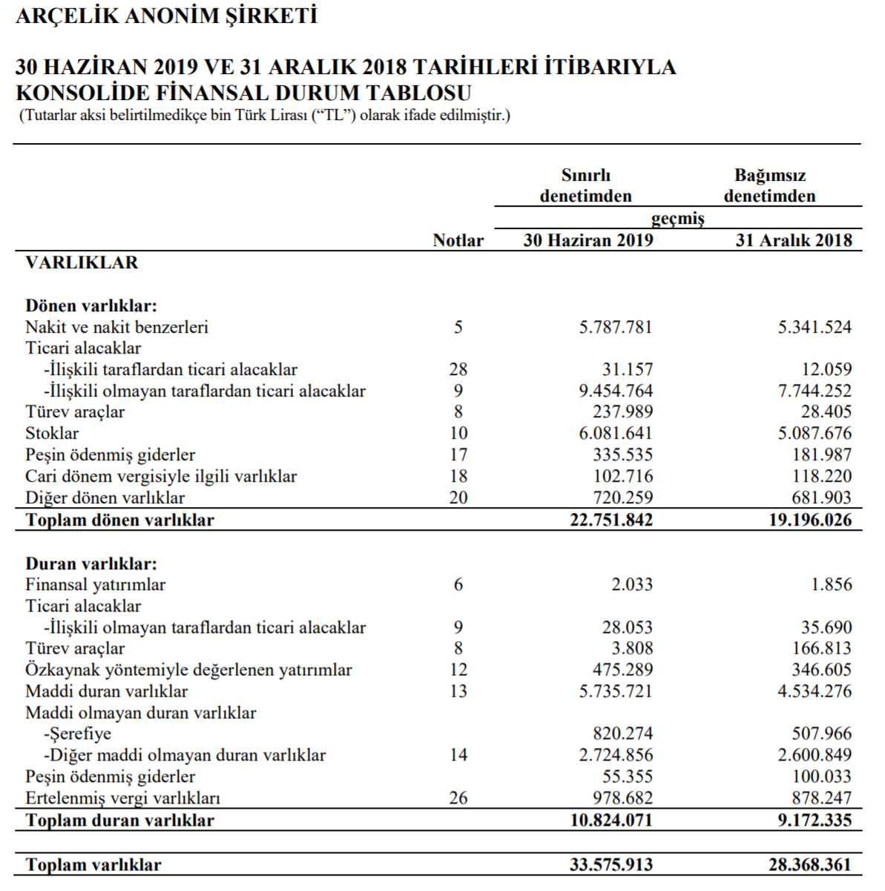
NTE 1010 – Introduction to Finance for Engineers
Financial Statements
Arçelik A.Ş. 30 June 2019
Assets
http://
www.arcelikas.com
UserFiles/file/Arcelik%20
2019
%202%C3%87%20
Finansal%20
Rapor.pdf

Slide 10
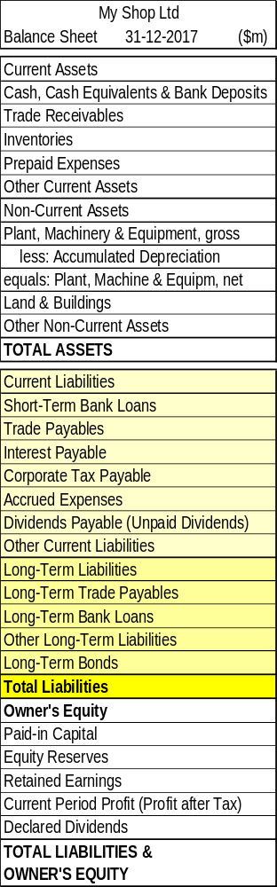
NTE 1010 – Introduction to Finance for Engineers
Balance Sheet
Liabilities
  Liabilities are obligations of the business to provide cash, or some other form of benefit to other individuals and organizations apart from the owners.
  Once a liability has been incurred by a business, it will remain as an obligation until it is settled.
  Liabilities are classified into two groups:
  Current liabilities are basically amounts due for settlement in the short term.
  They have to meet any one of the following four criteria:
  expected to be settled within the normal course of the business’ operating cycle
  due to be settled within 12 months of the balance sheet date
  held primarily for trading purposes
  Business does not have the right to defer settlement beyond 12 months after the balance sheet date
  Non-current liabilities represent those amounts due to outside parties that are not current liabilities.

Slide 11
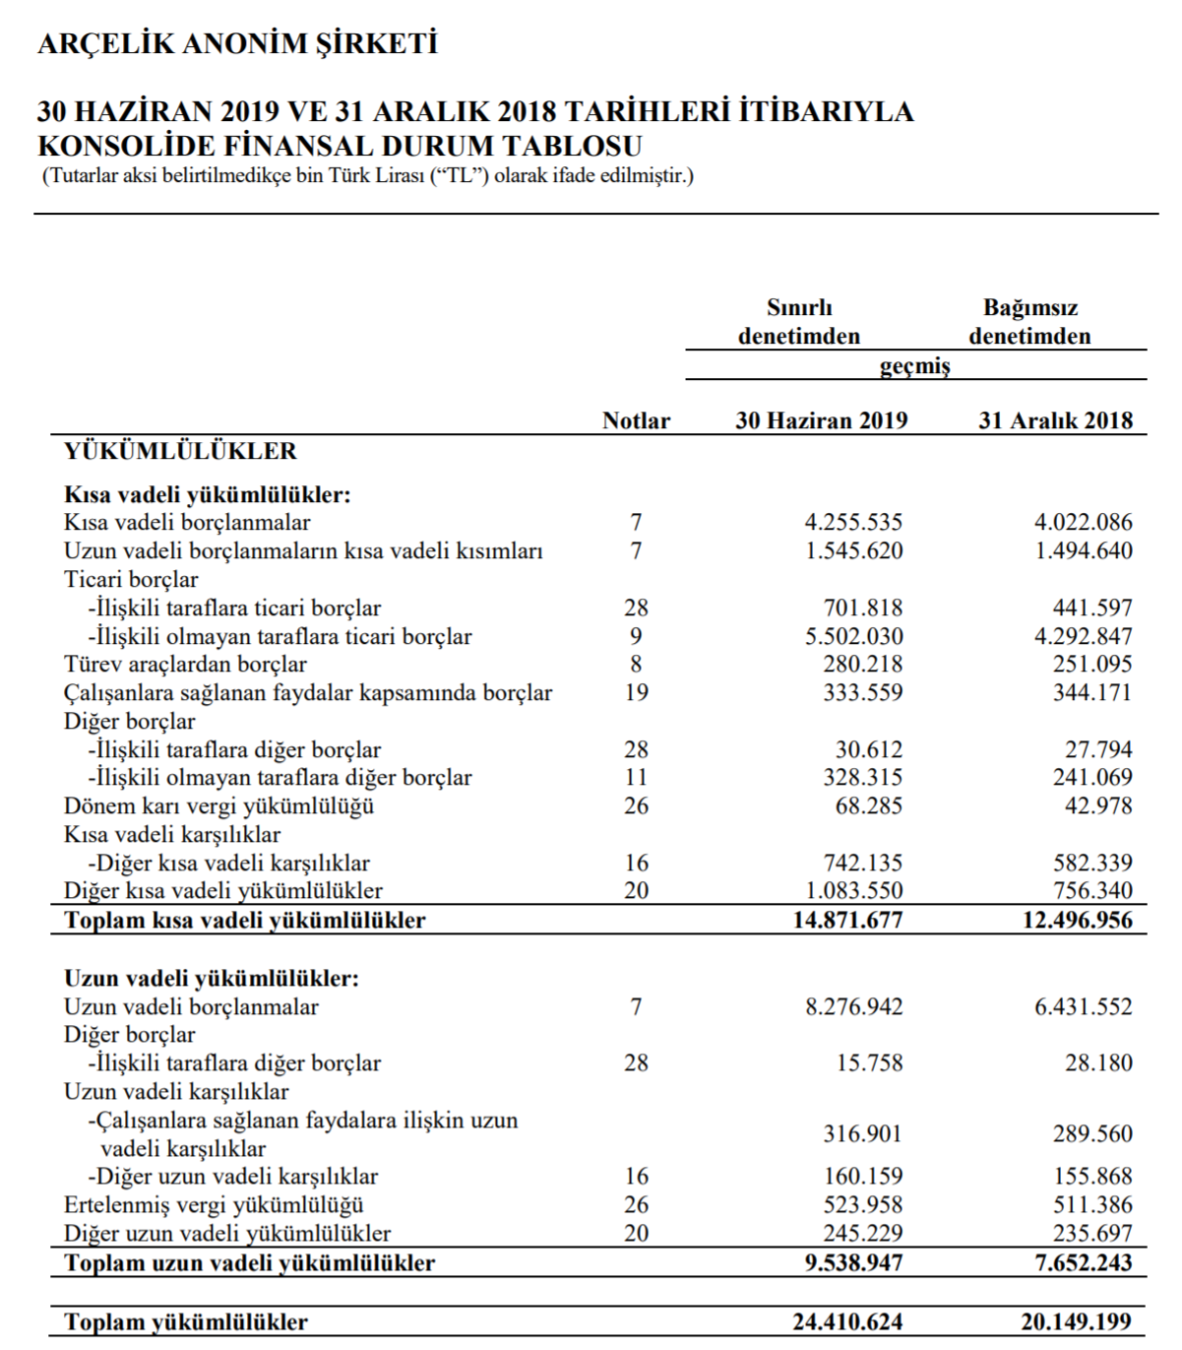
NTE 1010 – Introduction to Finance for Engineers
Financial Statements
Arçelik A.Ş. 30 June 2019
Liabilities
http://
www.arcelikas.com
UserFiles/file/Arcelik%20
2019
%202%C3%87%20
Finansal%20
Rapor.pdf

Slide 12
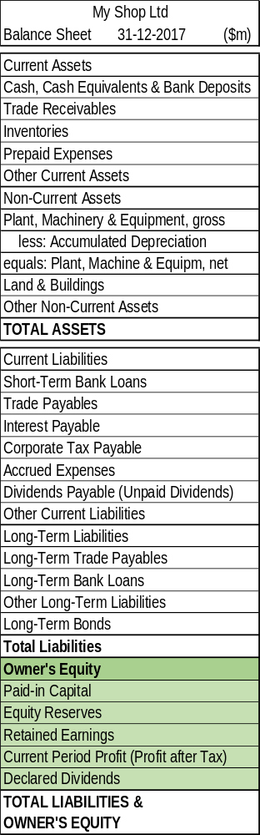
NTE 1010 – Introduction to Finance for Engineers
Balance Sheet
Owner’s Equity
  Represents the claim of the owners against the business.
  For accounting purposes, a clear distinction is made
  between the business and the owner(s).
  Viewed from this perspective,
  any funds contributed by the owners will be seen as
  coming from outside the business
  and will appear as a claim against the business in its balance sheet.

Slide 13
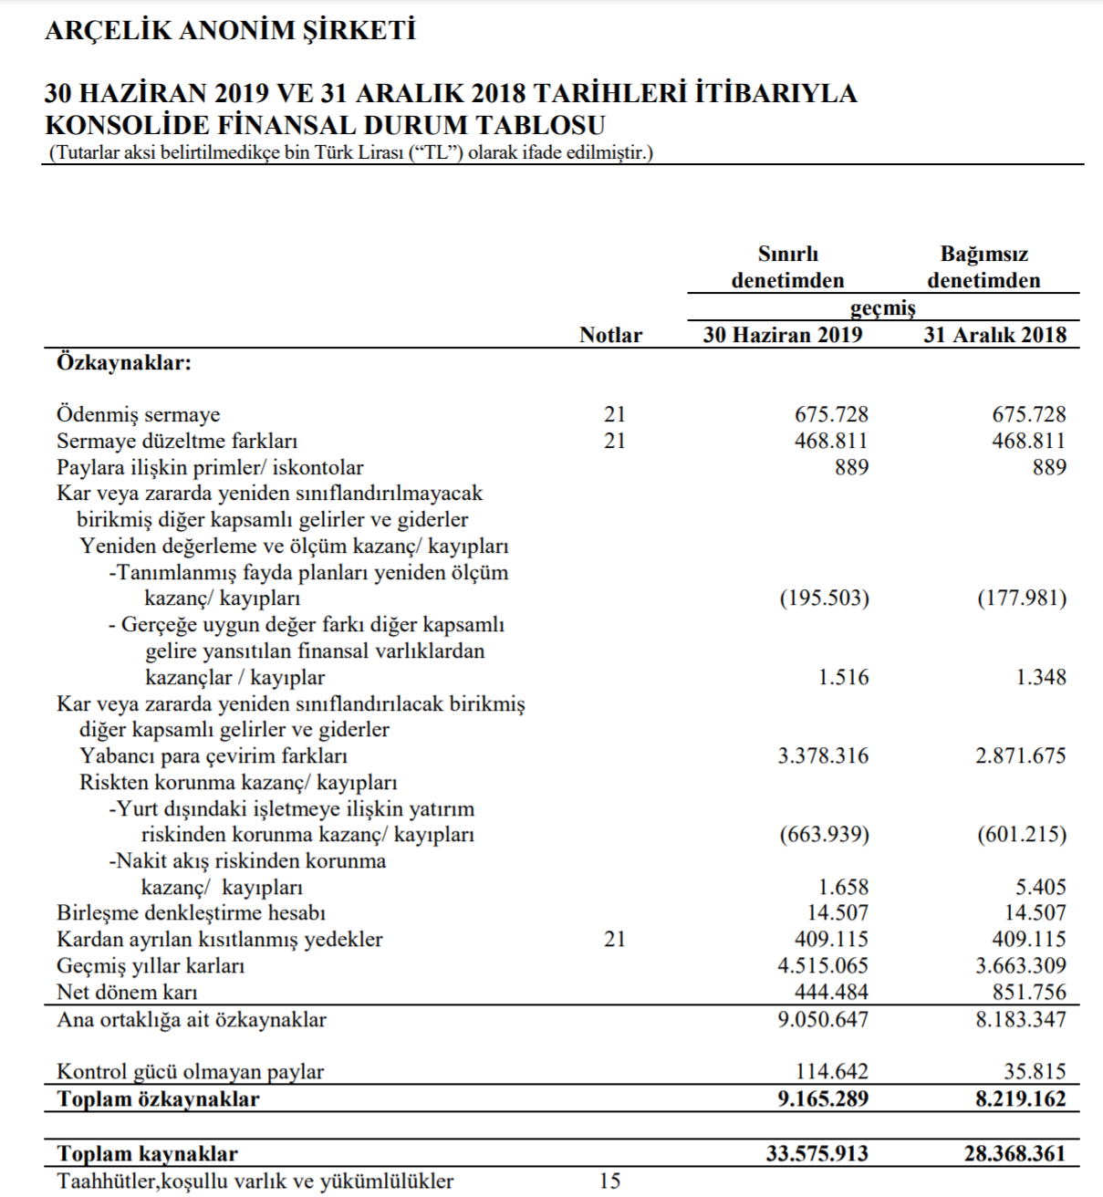
NTE 1010 – Introduction to Finance for Engineers
Financial Statements
Arçelik A.Ş. 30 June 2019
Owners’
Equity
http://
www.arcelikas.com
UserFiles/file/Arcelik%20
2019
%202%C3%87%20
Finansal%20
Rapor.pdf

Slide 14
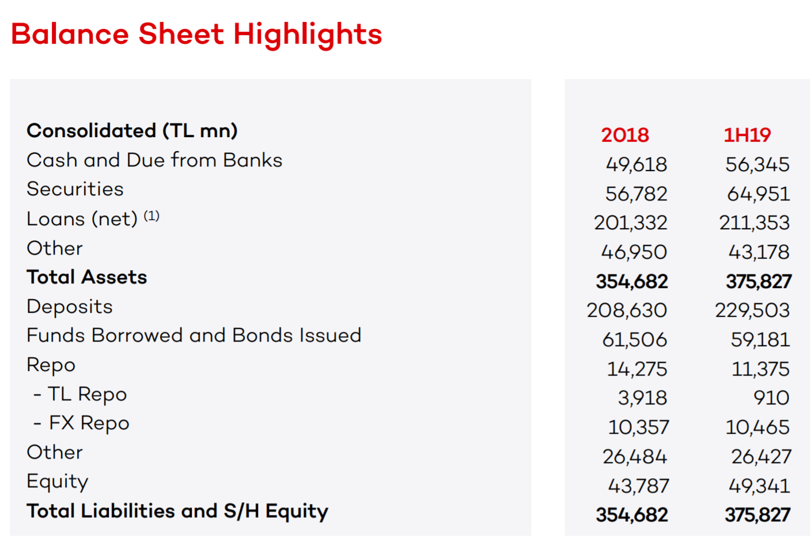
NTE 1010 – Introduction to Finance for Engineers
Financial Statements – Balance Sheet
Akbank T.A.Ş. 30 June 2019

Slide 15
NTE 1010.1 – Introduction to Finance for Engineers
Major Financial Statements
Balance Sheet: Asset Valuation
  Property, plant and equipment are shown at historic cost
    less any amounts written off for depreciation.
    However, fair values, if below depreciated cost, should rather be used.
  Where the amount that can be recovered from the tangible non-current assets
    is below the net book value,
    this lower amount should be reflected in the balance sheet.
  Intangible non-current assets broadly follow the same valuation rules as described above.
  Current assets are shown at the lower of cost or net realisable value.

Slide 16
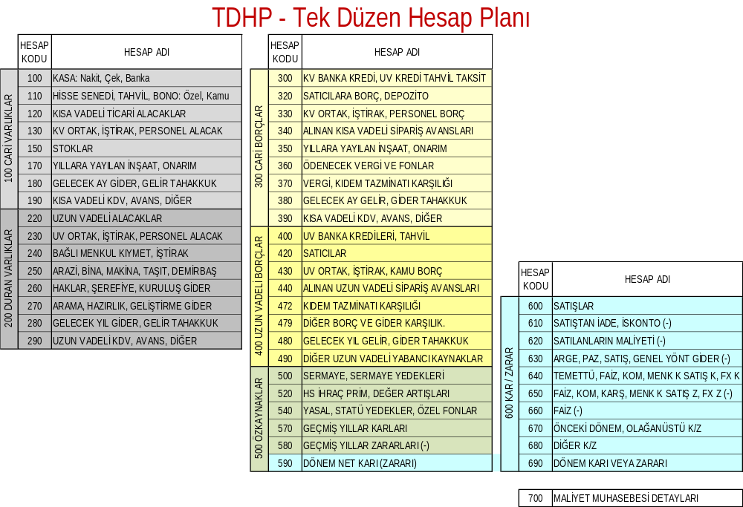

Slide 17
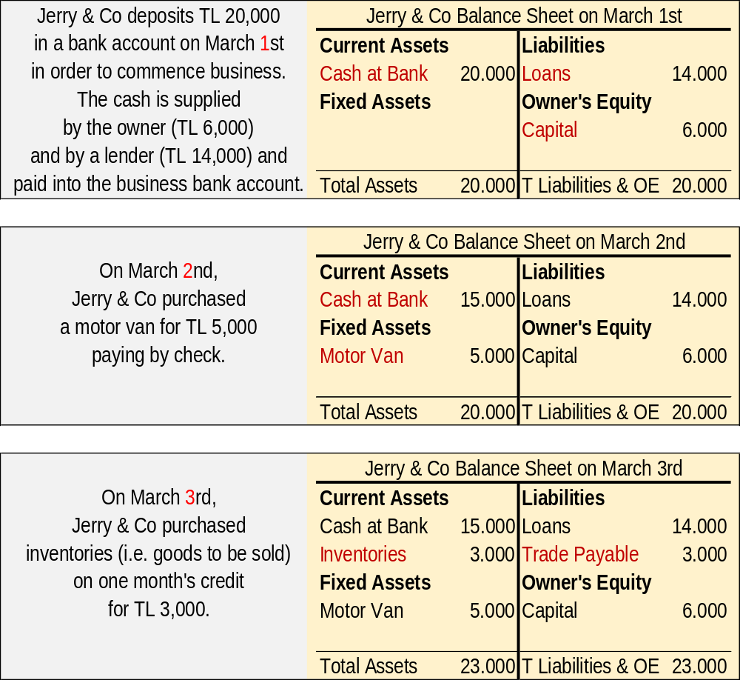
NTE 1010 – Introduction to Finance for Engineers
Major Financial Statements
Balance Sheet exercise

Slide 18
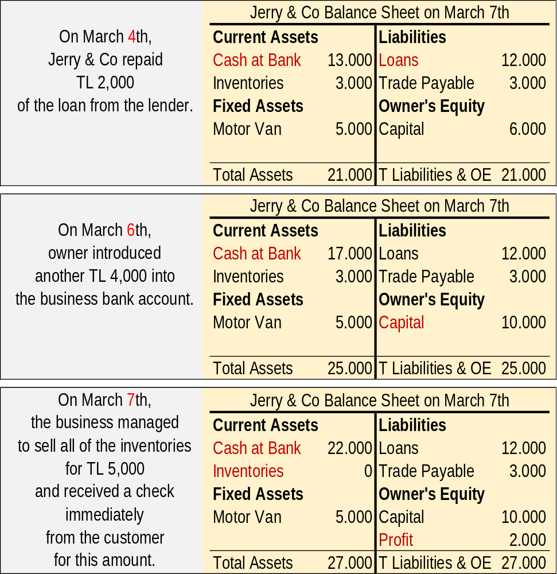
NTE 1010 – Introduction to Finance for Engineers
Major Financial Statements
Balance Sheet
exercise

Slide 19
Balance Sheet
Income Statement
Cash Flow Statement

Slide 20
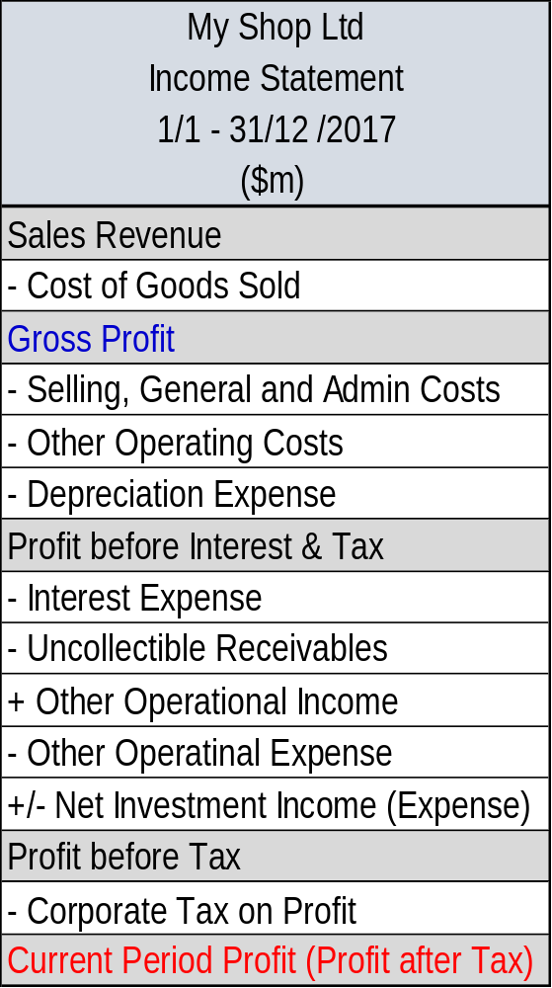
NTE 1010 – Introduction to Finance for Engineers
Major Financial Statements
Income Statement
  The purpose of the Income Statement,
  also called Profit and Loss Account,
  is to measure and report how much profit (wealth)
  the business has generated
  over a period
  (most commonly a year, a quarter, a month).

Slide 21
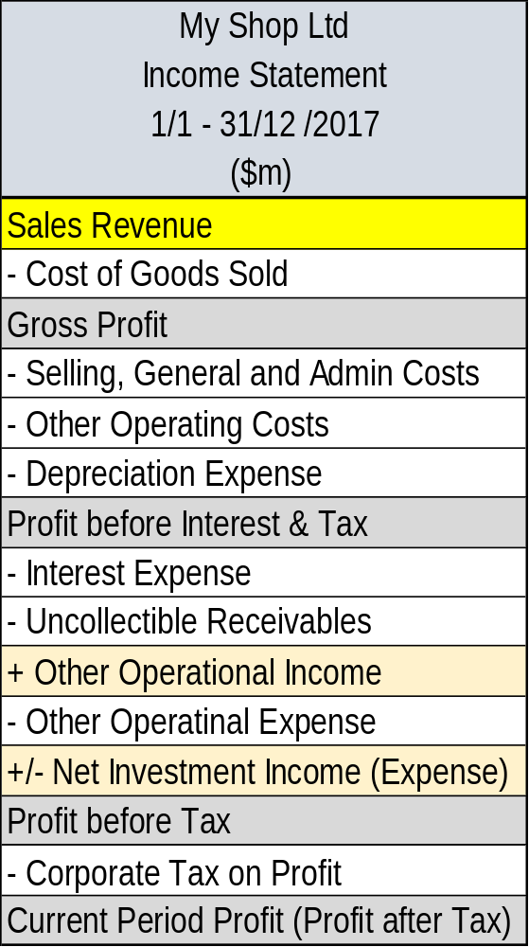
NTE 1010 – Introduction to Finance for Engineers
Income Statement
Revenue
  Recognition of sales revenue
  is independent of cash collection.
  This is Accrual Accounting.
  For credit sales,
  revenue is recognized before the cash collected.
  Advance payment received
  can not be recognized as revenue.
  Sales revenue is recognized
  when ownership and control of goods sold
  passes to the buyer.

Slide 22
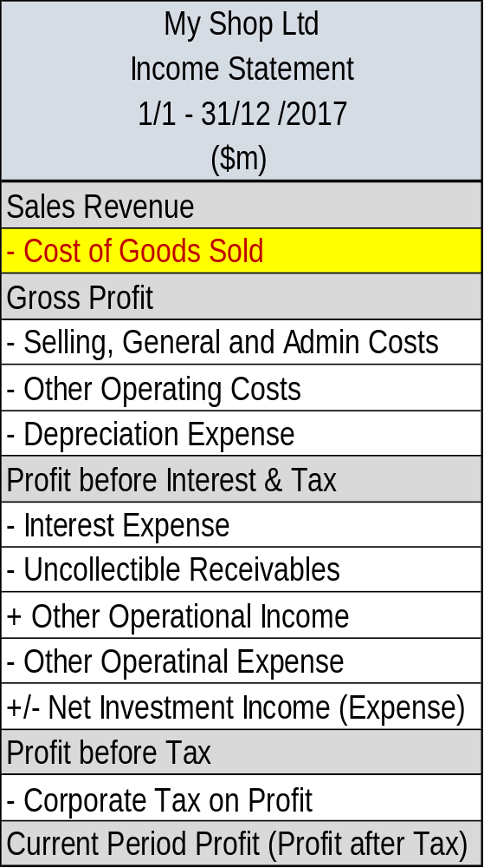
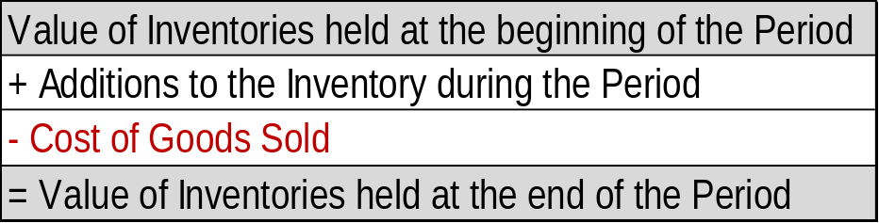
NTE 1010 – Introduction to Finance for Engineers
Income Statement
Cost of Goods Sold
    Commonly used methods of are the following:
  First In, First Out (FIFO)
    the earliest inventories held are the first to be sold.
  Last In, First Out (LIFO)
    the latest inventories held are the first to be sold.
  Weighted Average Cost (AVCO)

Slide 23
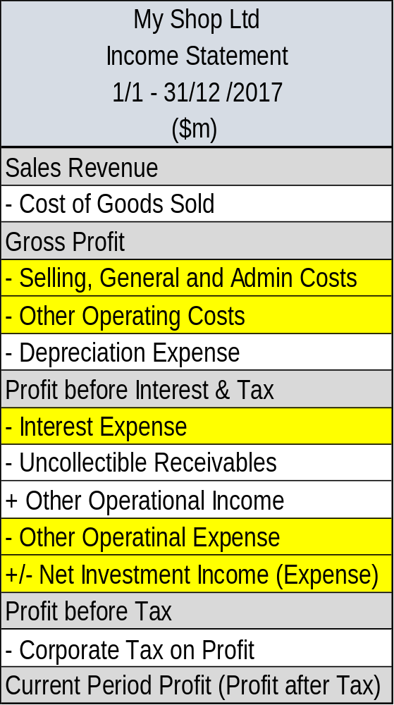
NTE 1010 – Introduction to Finance for Engineers
Income Statement
Expenses
  Expenses should be matched
  to the revenue
  that they helped to generate.
  Recognition of expenses is also
  independent of cash payment
  as per Accrual Accounting.
  Nevertheless, Accrual Accounting is subject to
  the Materiality Convention of accounting.

Slide 24
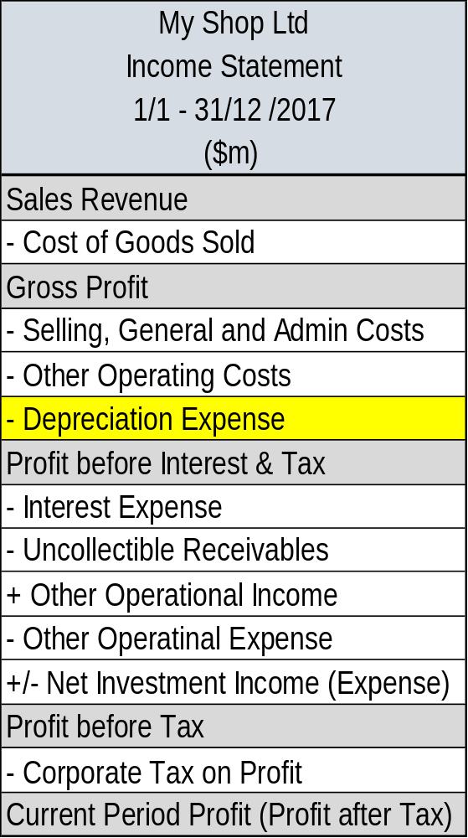
NTE 1010 – Introduction to Finance for Engineers
Income Statement
Depreciation
  Depreciation is an attempt to measure
  that portion of the cost of a non-current asset
  that is used to generate the revenue
  recognized during a particular period.
  The following have to be considered
  to calculate Depreciation Expense:
  Cost
  (all costs incurred to to make the asset ready for use),
  Useful life
  (shorter of the physical and economic life),
  Residual (salvage or disposal) value
  of the asset (needs to be estimated), and
  Depreciation method.

Slide 25
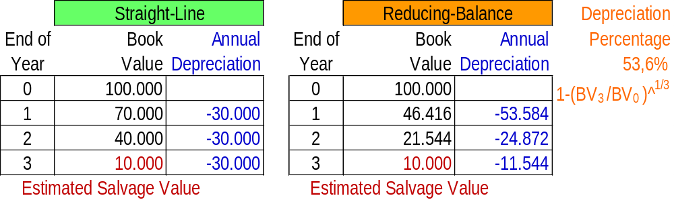
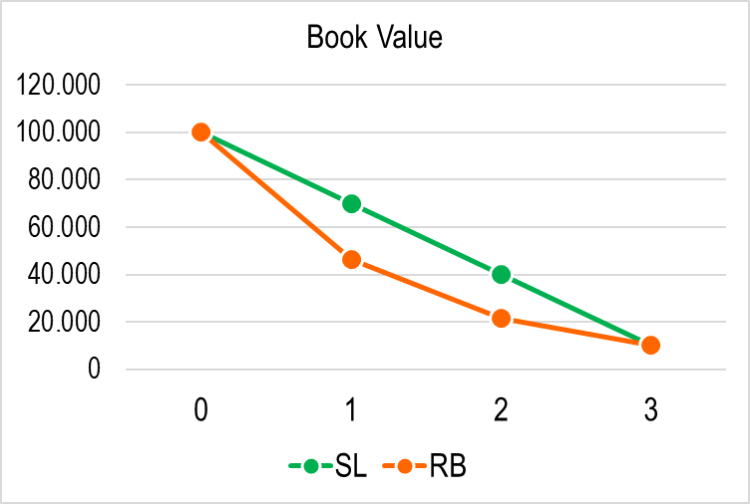
NTE 1010 – Introduction to Finance for Engineers
Income Statement
Depreciation
  Depreciation method (most commonly used are the following):

Slide 26
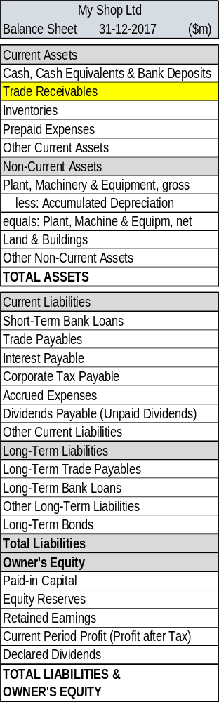
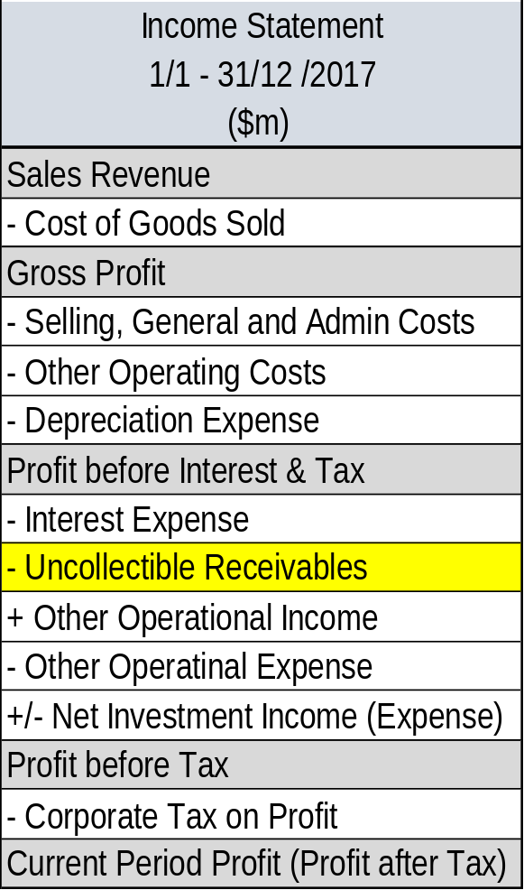
NTE 1010 – Introduction to Finance for Engineers
Income Statement
″Bad″ Receivables
  Many businesses sell goods
  on credit.
  When it becomes
  reasonably certain
  that the customer will never pay,
  the receivable is considered to be ″bad″.
  To provide a more realistic picture of
  the financial performance and position,
  ″bad″ receivables must be
  ″written off″ by
  reducing the receivables and
  increasing expenses.

Slide 27
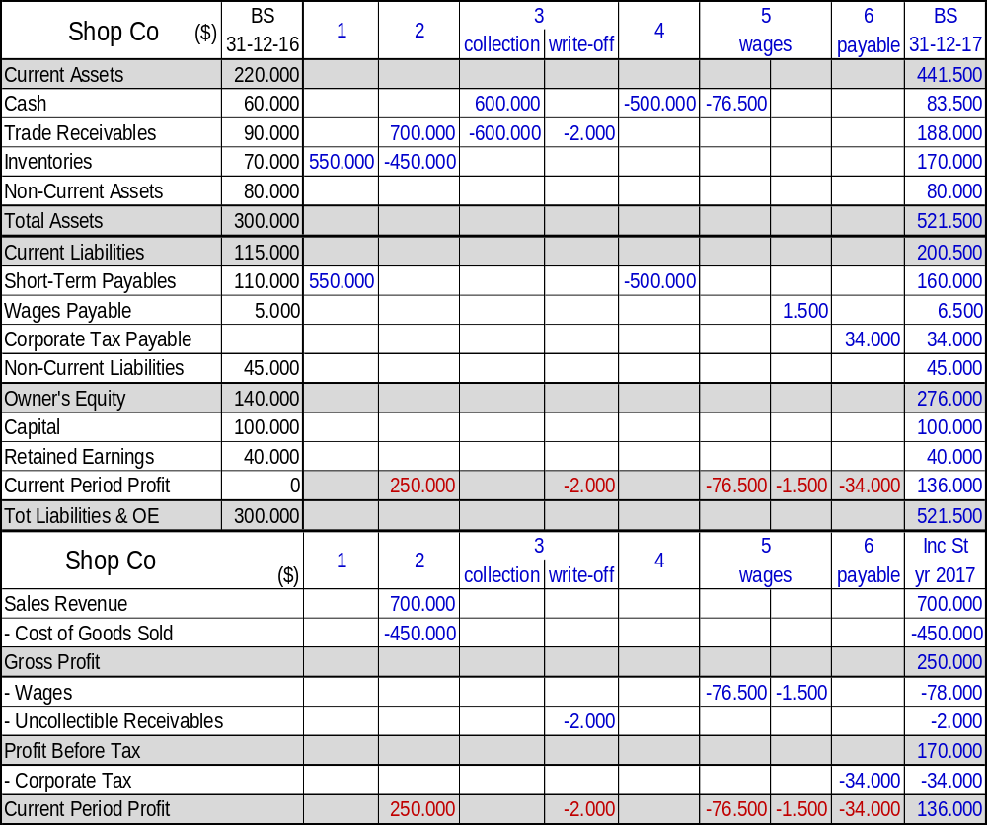
  BS & Income St
  exercise
  .
  Shop Co has the next Balance Sheet on 31-12-2016. The following is a summary of transactions that occurred during the year 2017: Prepare 2017 year-end Balance Sheet and 2017 Income Statement of Shop Co.
  1 - Inventories totalling $550,000 were bought on credit.
  2 - Sales revenue on credit totalled $700,000 (cost of goods sold was $450,000).
  3 - Receipts from trade receivables totalled $600,000. At year-end, it was clear that a trade debtor who owed $2,000 would not be able to pay any part of the debt.

Slide 28
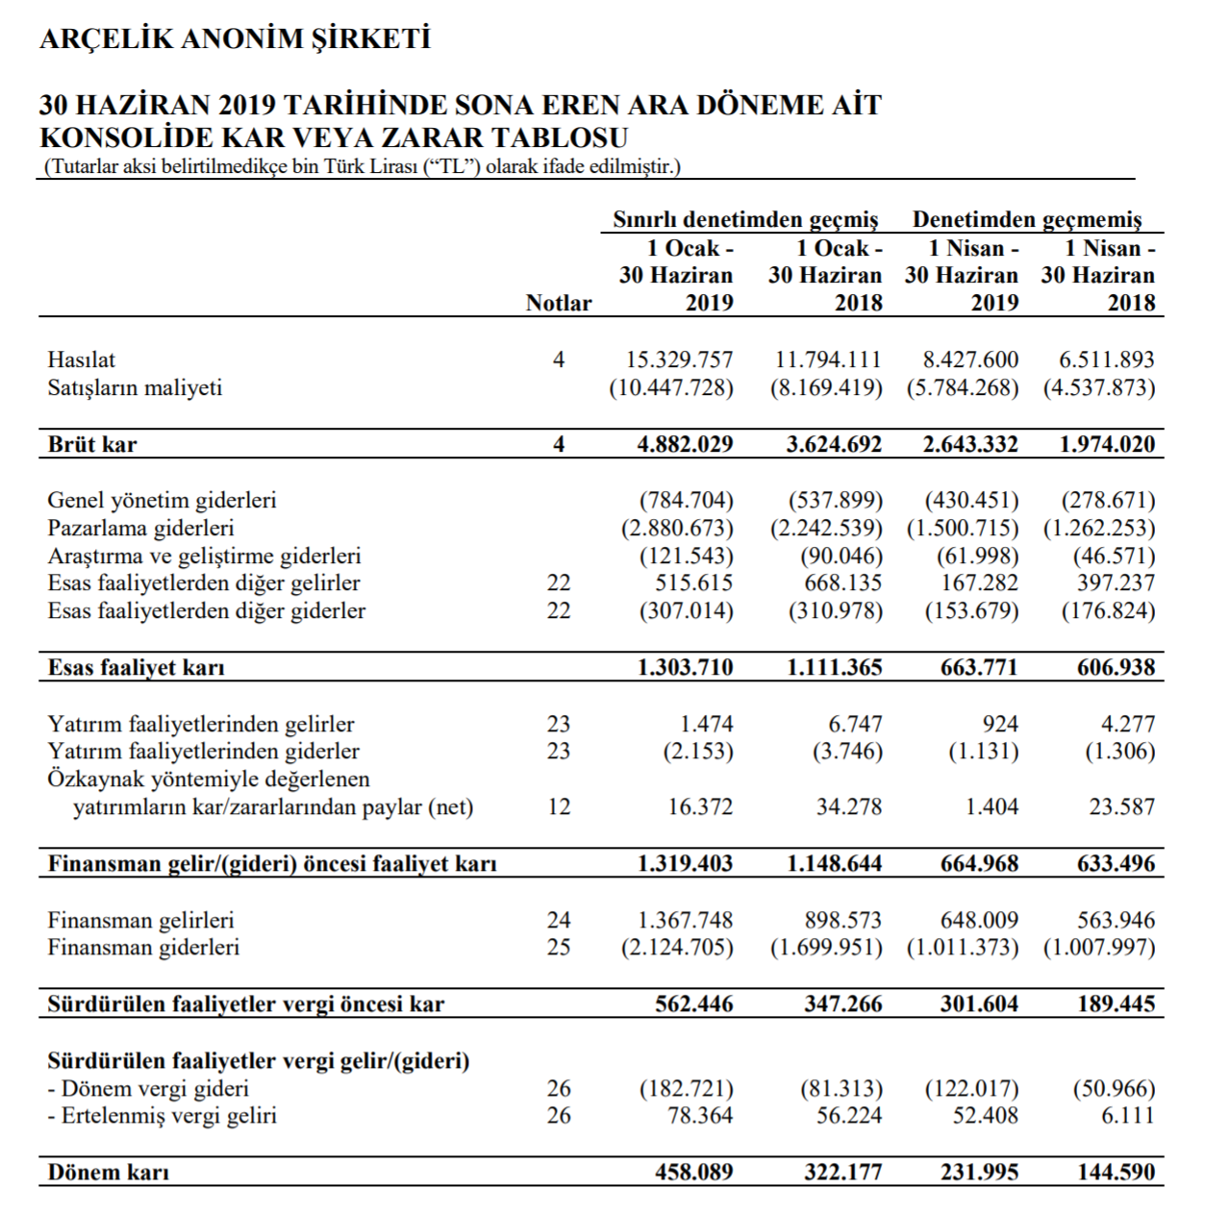
NTE 1010 – Introduction to Finance for Engineers
Financial Statements
Arçelik A.Ş. 1 January
- 30 June 2019
Income
Statement
http://
www.arcelikas.com
UserFiles/file/Arcelik%20
2019
%202%C3%87%20
Finansal%20
Rapor.pdf

Slide 29
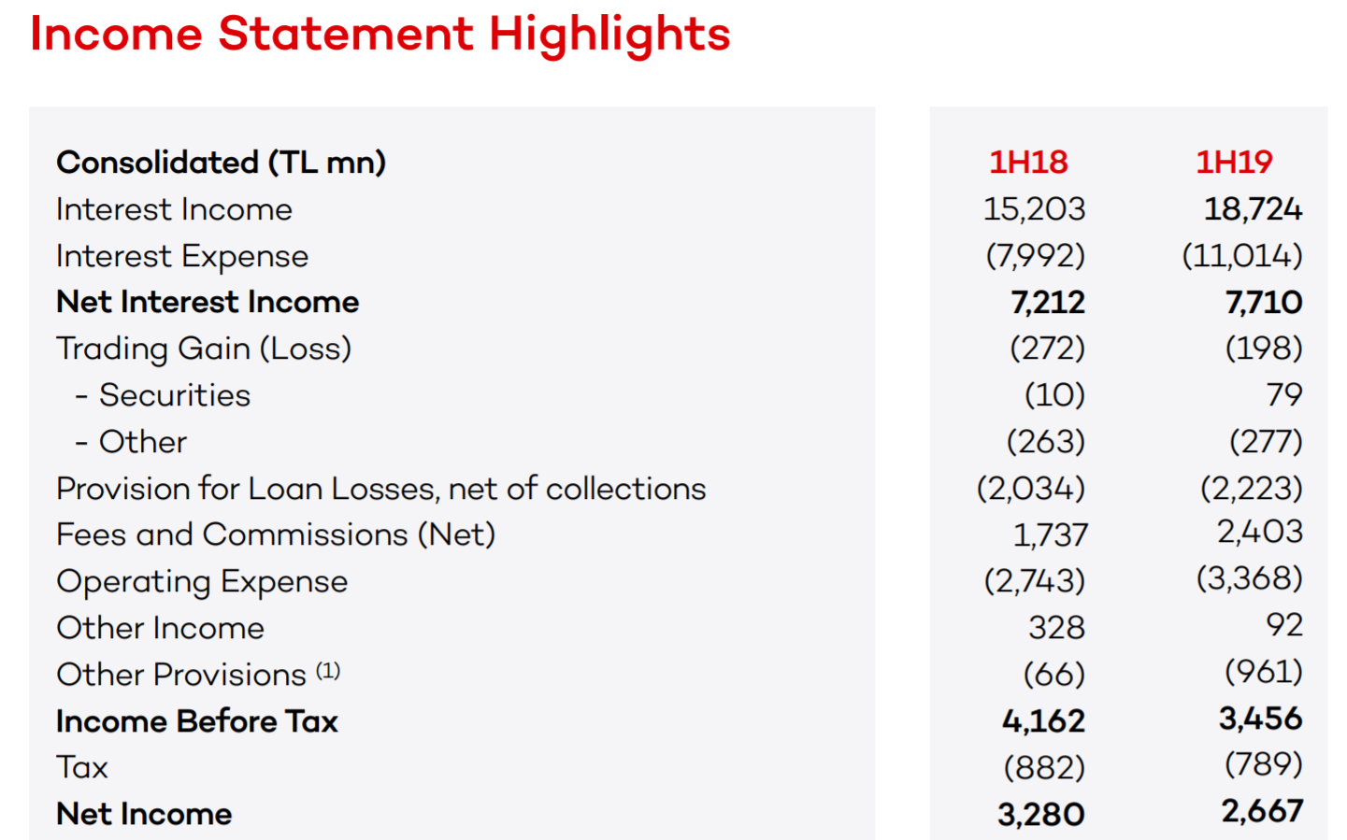
NTE 1010 – Introduction to Finance for Engineers
Financial Statements – Income Statement
Akbank T.A.Ş. 1 January - 30 June 2019

Slide 30
Balance Sheet
Income Statement
Cash Flow Statement

Slide 31
NTE 1010 – Introduction to Finance for Engineers
Major Financial Statements
Cash Flow Statement
  Income Statement sets out the revenue and expenses,
  rather than the cash receipts and cash payments, for the period.
  Thus, Income Statement may have little or no relation
  to the cash generated for the period.
  Why is cash so important?
  Because, people and organizations will not normally accept other than cash
  in settlement of their claims against the business.
  When businesses fail, it is their inability to find the cash
  to pay the amounts owed that really pushes them under.
  Analysts tend to watch most carefully when trying to assess
  the ability of businesses to survive
  and/or take advantage of commercial opportunities as they arise.

Slide 32
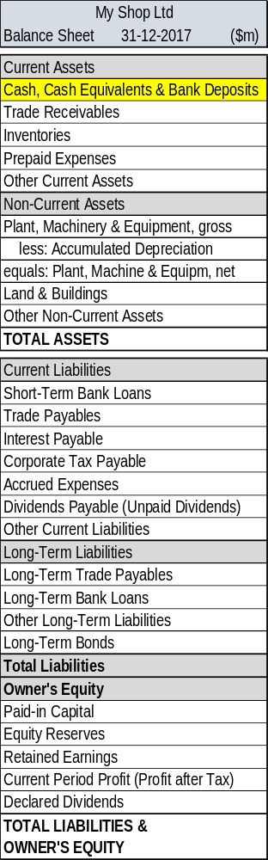
NTE 1010 – Introduction to Finance for Engineers
Balance Sheet
Cash and Cash Equivalents
  Cash are banknotes and coins in hand
  and deposits in banks and similar institutions
  that are accessible to the business on demand.
  Cash equivalents are short-term, highly liquid investments
  that are readily convertible to known amounts of cash
  and which are subject to insignificant risk of changes of value.
  Cash equivalents are held for
  the purpose of meeting short-term cash commitments
  rather than for investment or other purposes.

Slide 33
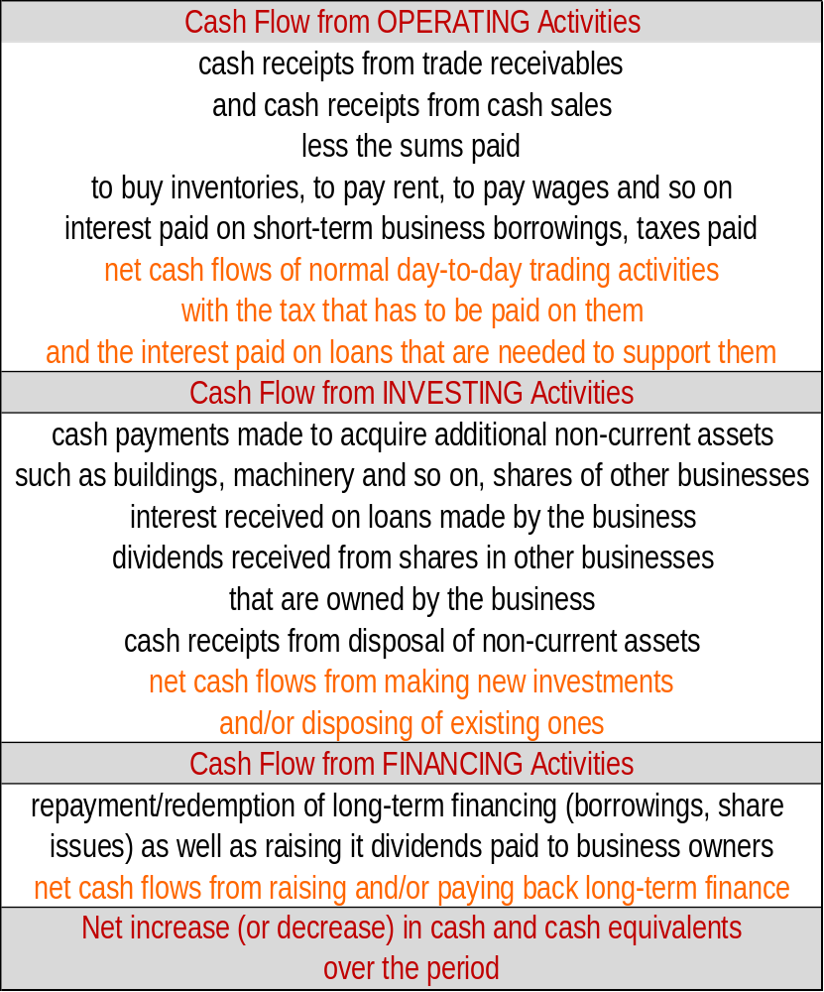
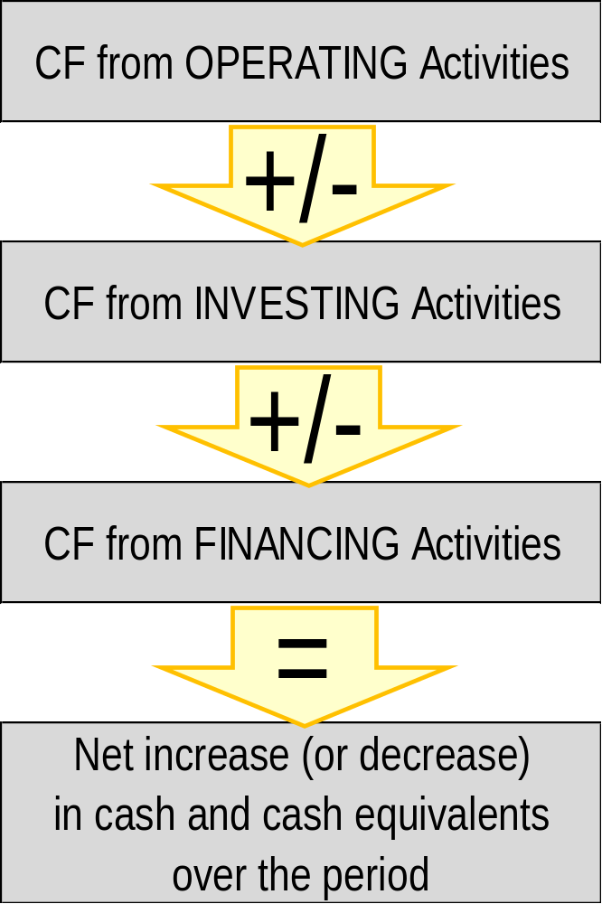
NTE 1010 - Introduction to Finance for Engineers
Cash Flow Statement
Standard Layout

Slide 34
NTE 1010 – Introduction to Finance for Engineers
Cash Flow Statement
Normal Direction of Cash Flows
  Normally ″operating activities″ provide positive cash flows.
  Investing activities typically cause net negative cash flows.
  This is because most types of non-current asset wear out,
  and because businesses tend to seek to expand their asset base.
  When a business sells some non-current assets,
  this will give rise to positive cash flows,
  but in net terms the cash flows are normally negative
  with cash spent on new assets outweighing that received from disposal of old ones.
  Financing can go in either direction, depending on the financing strategy at the time.
  Since businesses seek to expand, there is a general tendency for this area to lead to cash coming into the business rather than leaving it.

Slide 35
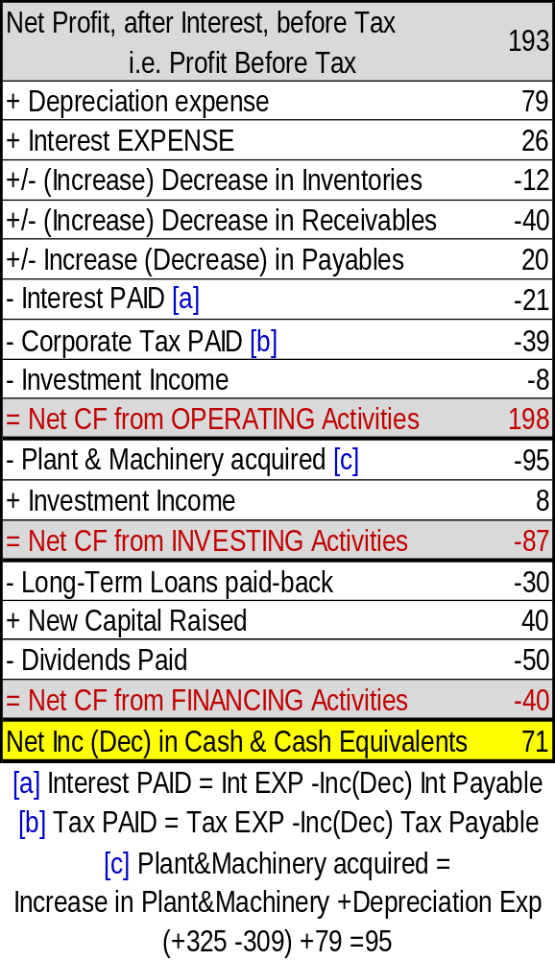
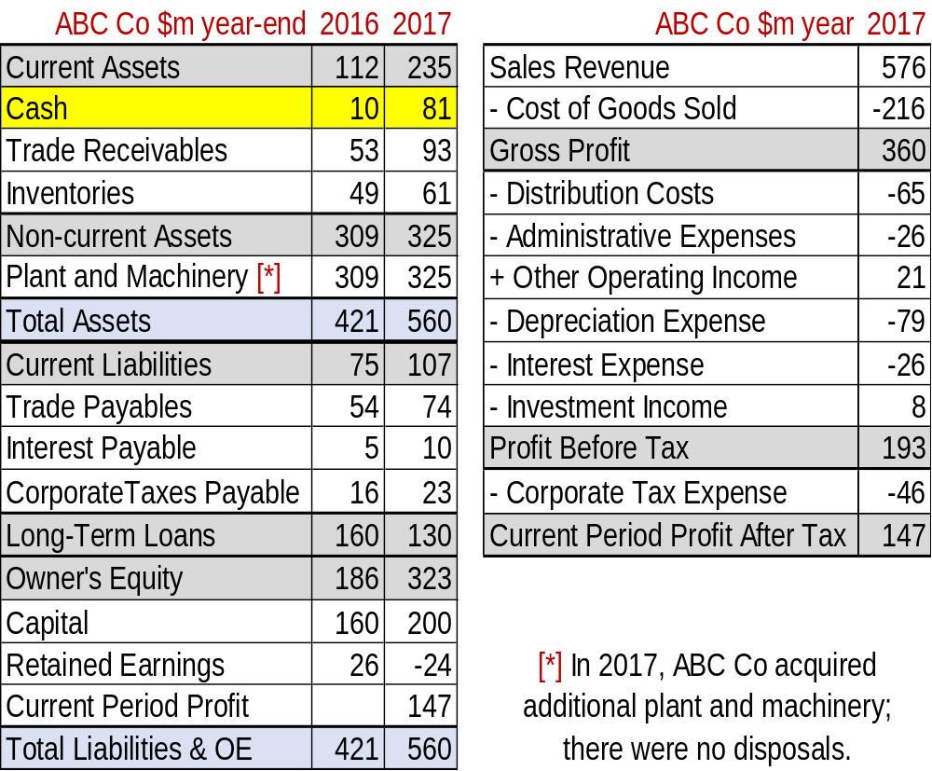
NTE 1010
Introduction to Finance for Engineers
Cash Flow Statement exercise

Slide 36
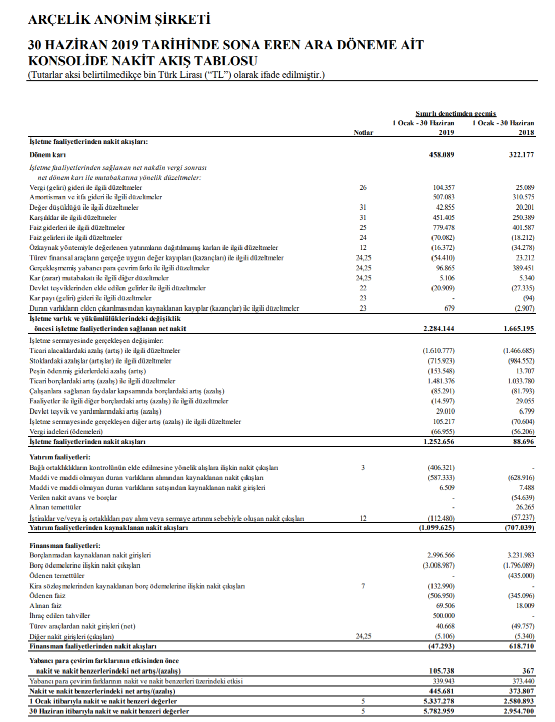
NTE 1010 – Introduction to Finance for Engineers
Financial Statements
Arçelik A.Ş. 1 January
- 30 June 2019
Cash Flow
Statement
http://
www.arcelikas.com
UserFiles/file/Arcelik%20
2019
%202%C3%87%20
Finansal%20
Rapor.pdf

